Slide 1
Heart Disease Data Analysis
A Comprehensive Study on Dimensionality Reduction, Manifold Learning, and Responsible AI
Edoardo Cipriano, Clara Reynolds, Joep Leeuwenburgh, Oghenekaro Arausi
OPIT - Open Institute of Technology | December 7, 2025

Slide 2
Analysis Overview
The Challenge
Key Discovery
Cardiovascular diseases cause 17.9 million deaths annually worldwide. Early detection through machine learning offers promising improvements in patient outcomes and healthcare cost reduction.
Over 70% of the original dataset consisted of duplicates, reducing 1,025 records to 302 unique patient profiles after rigorous cleaning.
Our Approach
Critical Insight
We analyzed the UCI Heart Disease dataset using advanced dimensionality reduction and manifold learning techniques, uncovering complex nonlinear structures in cardiac health data.
Heart disease exists on a continuous spectrum rather than as a binary condition, better captured by nonlinear methods than traditional approaches.

Slide 3
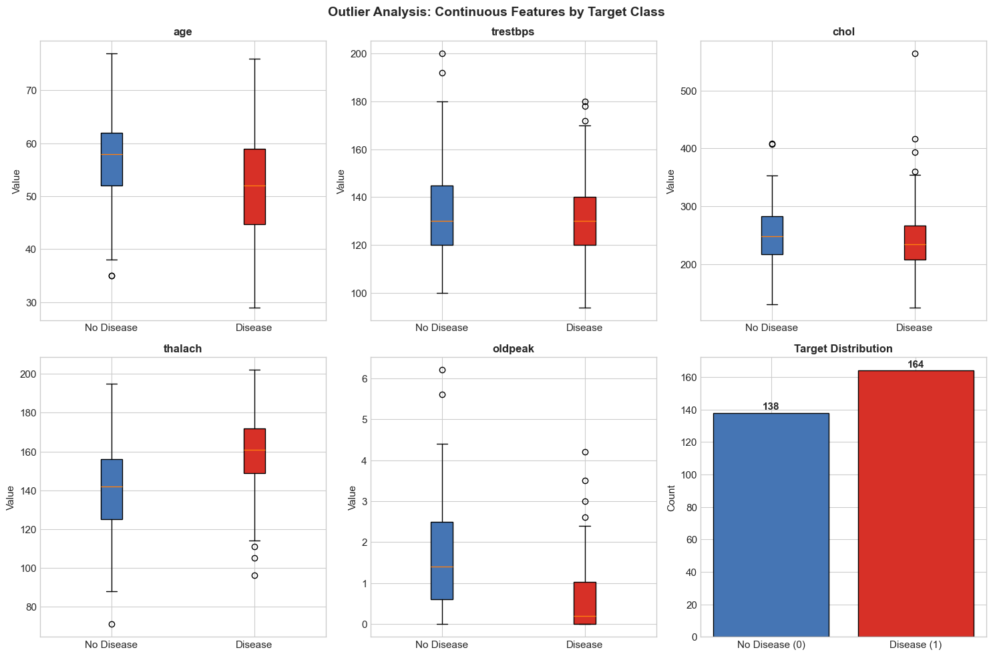
Dataset Overview & Preprocessing
01
Initial Dataset
1,025 patient records with 14 clinical attributes including demographics, measurements, and diagnosis
02
Duplicate Removal
723 duplicate rows identified and removed (70.5% of data), highlighting critical data quality issues
03
Outlier Analysis
IQR method applied to continuous variables, particularly cholesterol and blood pressure measurements
04
Feature Scaling
StandardScaler normalization to zero mean and unit variance for distance-based algorithms
05
Final Dataset
302 unique patient records ready for advanced analysis with 138 healthy and 164 disease cases

Slide 4
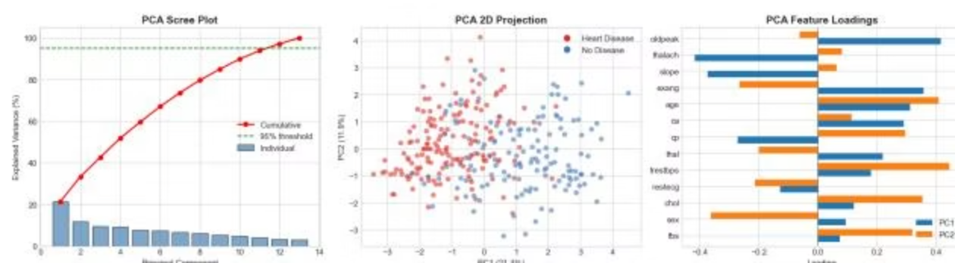
Principal Component Analysis Results
Variance Explained
Key Feature Loadings
The first two principal components capture only 33.3% of total variance (PC1: 21.4%, PC2: 11.9%).
PC1: Dominated by oldpeak (ST depression) and thalach (max heart rate)
Seven components required to reach 73.6% cumulative variance, indicating complex multi-dimensional structure.
PC2: Influenced by exang (exercise-induced angina) and age
Considerable class overlap suggests linear separation is insufficient

Slide 5
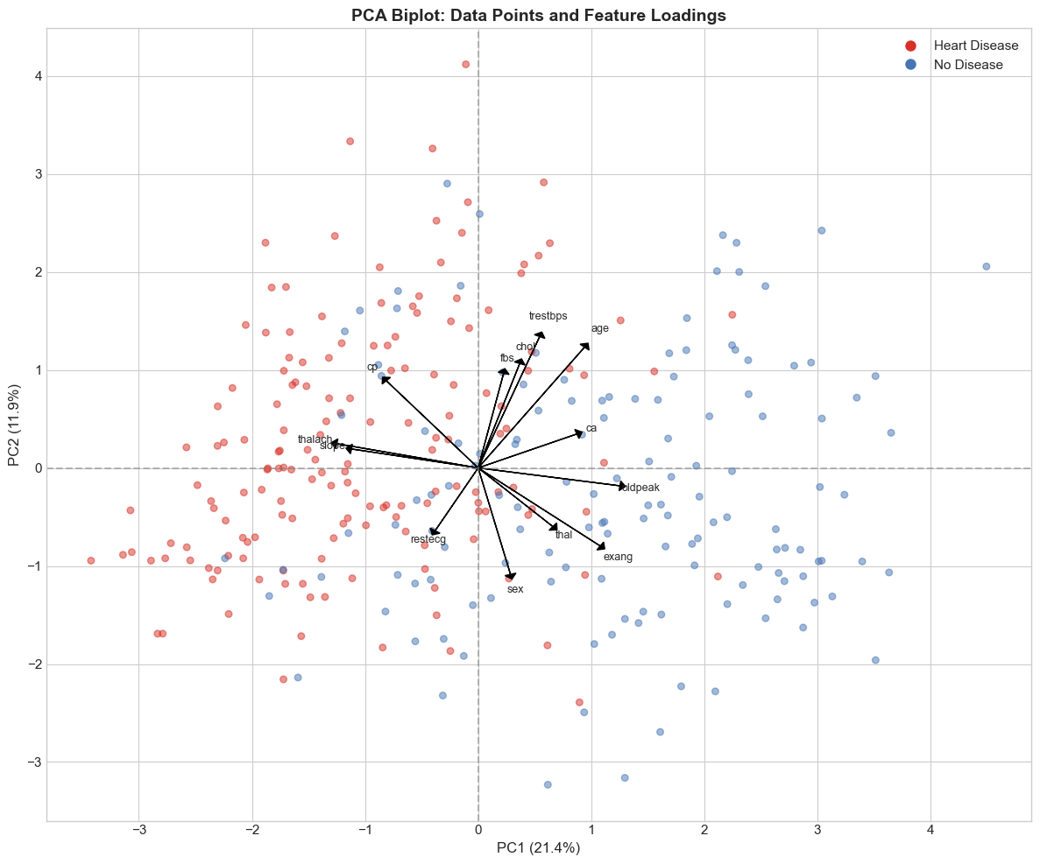
PCA Biplot: Feature Contributions
Opposing Forces
Correlated Features
Class Overlap
Oldpeak and thalach point in opposite directions along PC1, representing contrasting cardiac indicators
Red (disease) and blue (healthy) points intermingle, demonstrating limitations of linear dimensionality reduction
Age, trestbps, and chol vectors align, indicating positive correlation among these demographic and clinical measures

Slide 6
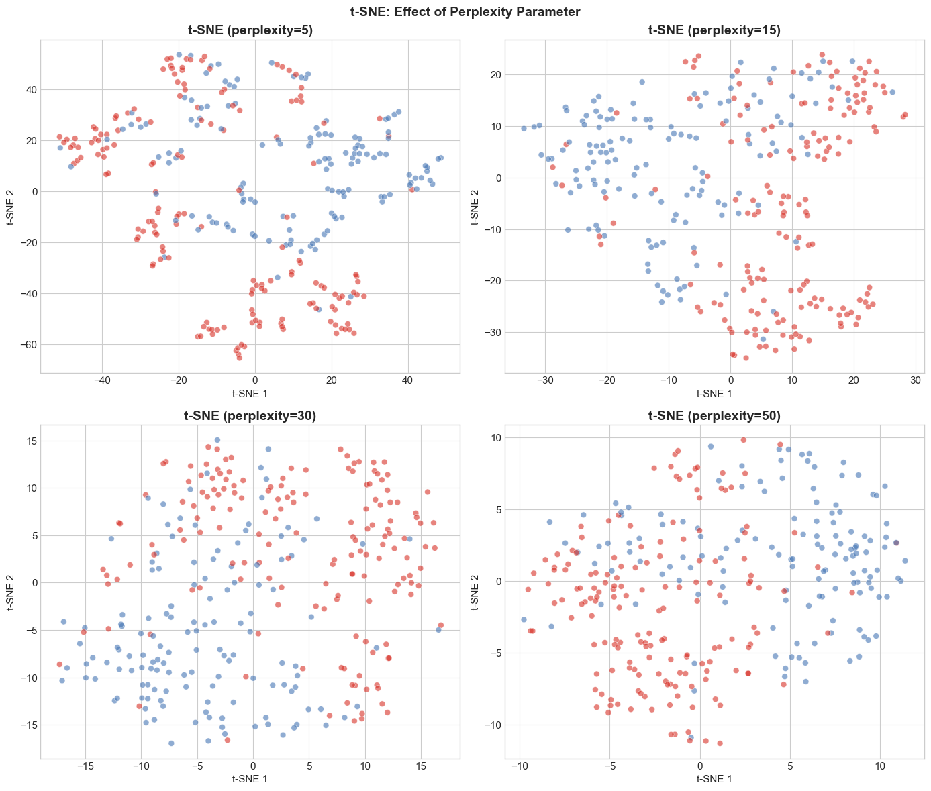



Nonlinear Methods: t-SNE Analysis
t-SNE reveals clear cluster separation between disease and healthy populations that was invisible in PCA projection, successfully capturing nonlinear relationships.
Perplexity = 5
Fragmented clusters, over-emphasis on local structure
Perplexity = 30
Optimal balance between local and global structure preservation
Perplexity = 50
More globular structures, emphasis on global patterns

Slide 7
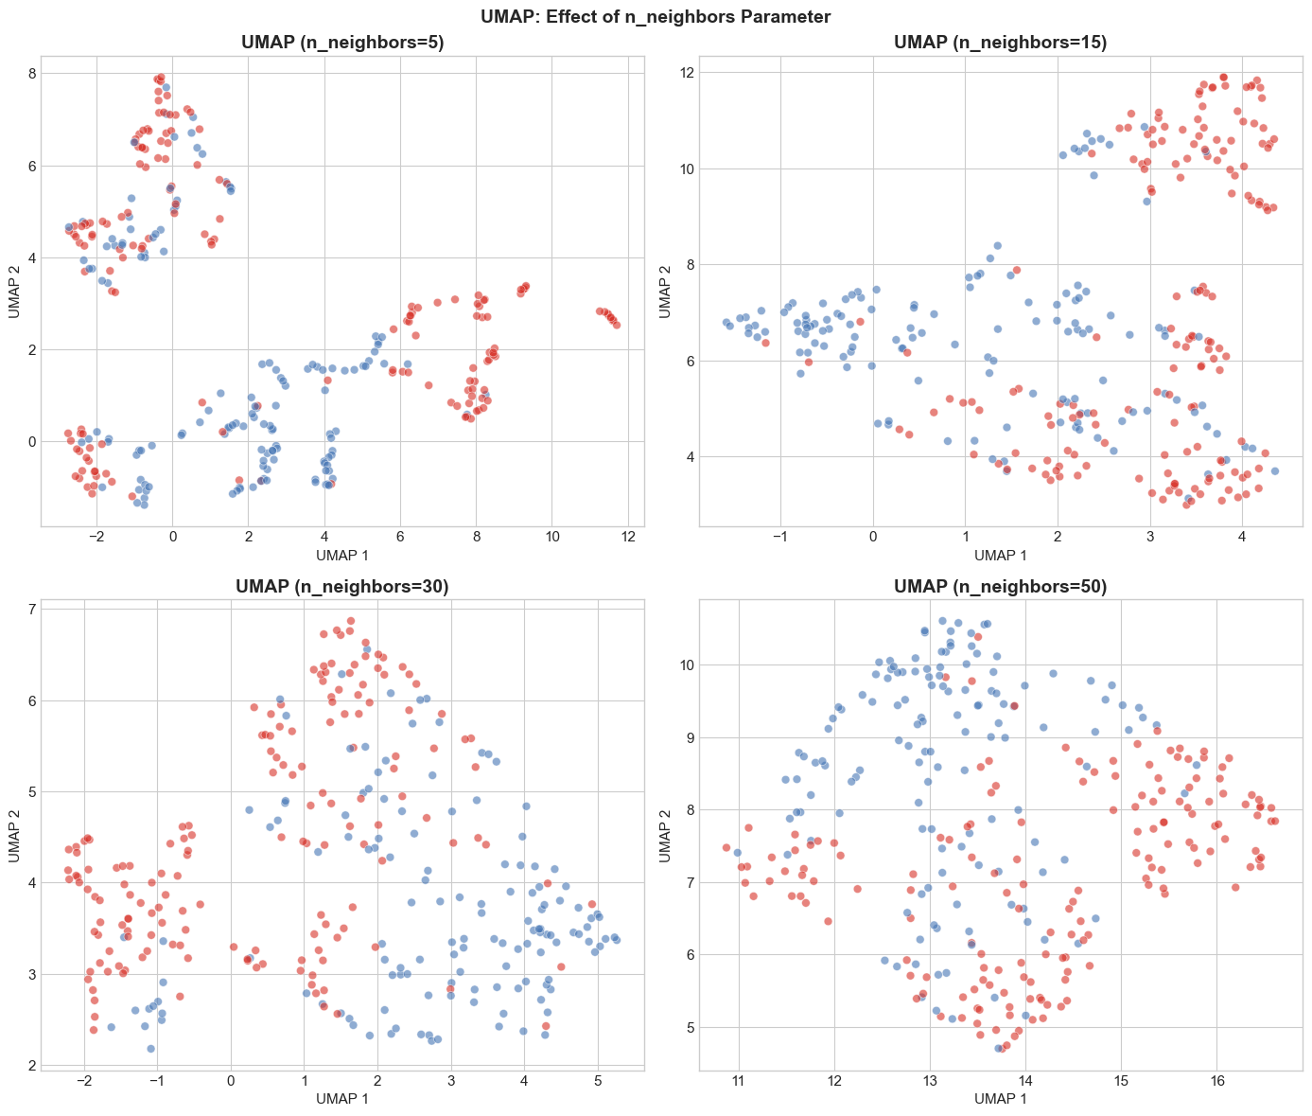
UMAP: Fast & Effective Visualization
Parameter Sensitivity
The n_neighbors parameter controls the balance between local and global structure:
Small values (5, 15): Emphasize local structure with tighter clusters
Large values (30, 50): Capture more global relationships
Performance Advantage
UMAP demonstrates comparable visualization quality to t-SNE but with significantly faster computation time, making it ideal for larger datasets.
Successfully preserves both local and global structure simultaneously.

Slide 8
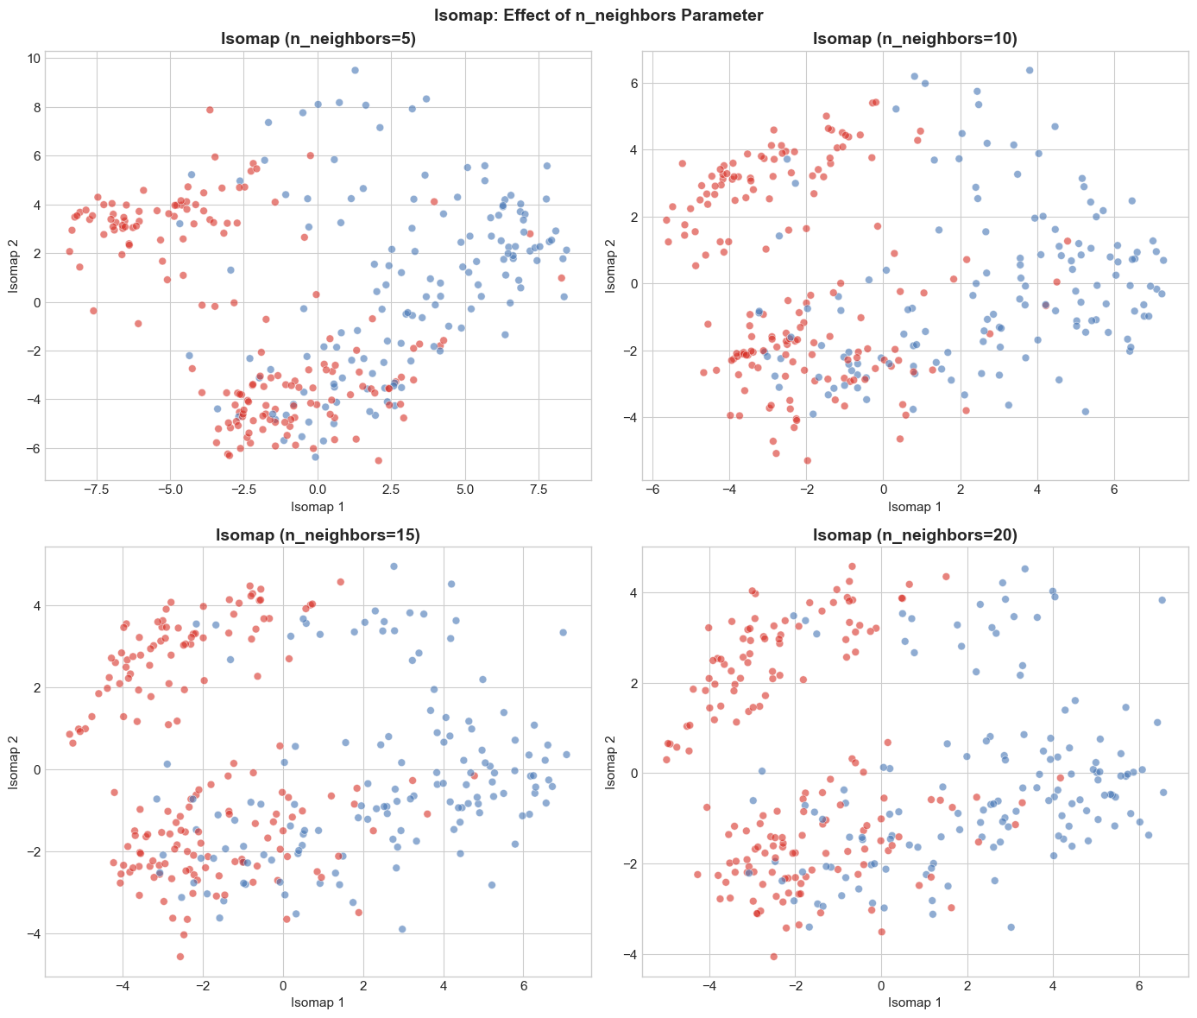
Manifold Learning: Isomap
Geodesic Distance Approach
Isomap extends classical MDS by using geodesic distances along the data manifold rather than Euclidean distances.
Key Findings
Reveals heart disease data lies on a curved manifold
Disease and healthy populations occupy different manifold regions
Higher neighbor values produce smoother embeddings
Excellent preservation of global structure

Slide 9
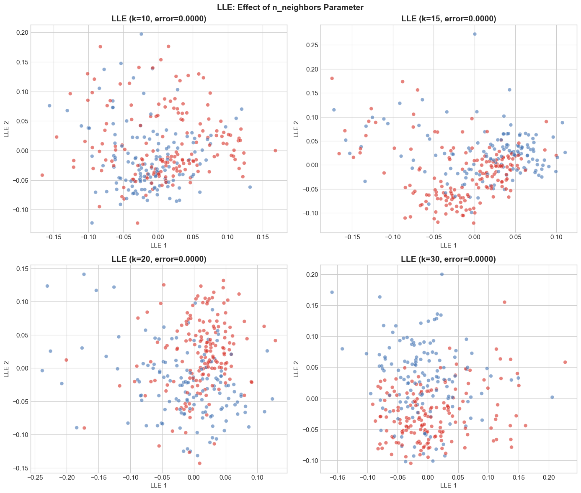

Locally Linear Embedding (LLE)
LLE preserves local geometry by reconstructing each point as a weighted linear combination of its k-nearest neighbors, revealing fine-grained patient clusters within broader disease categories.
The optimization finds low-dimensional coordinates that preserve local neighborhood relationships from high-dimensional space.

Slide 10

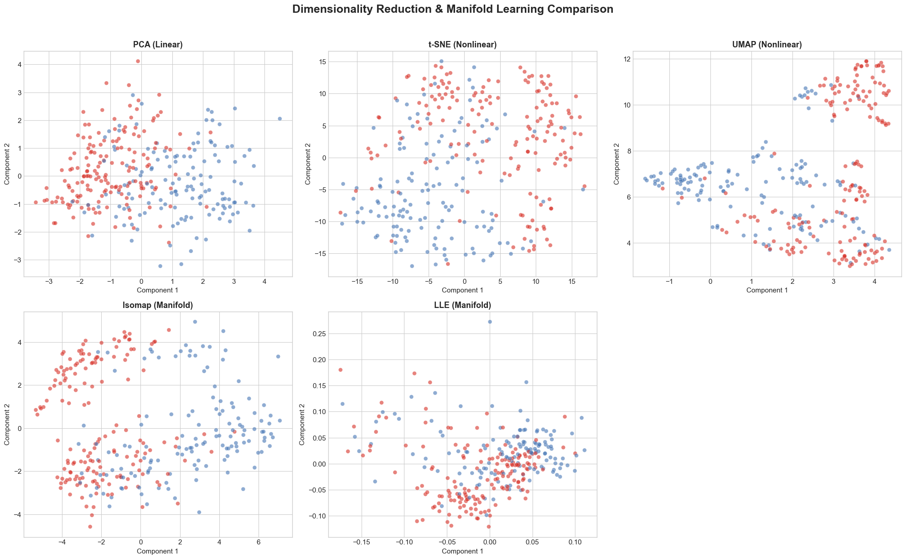




Comprehensive Method Comparison
PCA (Linear)
Fast computation, good global structure, but limited local structure preservation. Only 33% variance captured.
t-SNE (Nonlinear)
Excellent local structure, limited global preservation. Slow but achieves clearest class separation.
UMAP (Nonlinear)
Good balance of local and global structure with moderate speed. Best overall performance.
Isomap (Manifold)
Excellent global structure via geodesic distances. Reveals curved manifold geometry.
LLE (Manifold)
Excellent local structure preservation. Fast computation, reveals fine-grained patient subgroups.

Slide 11
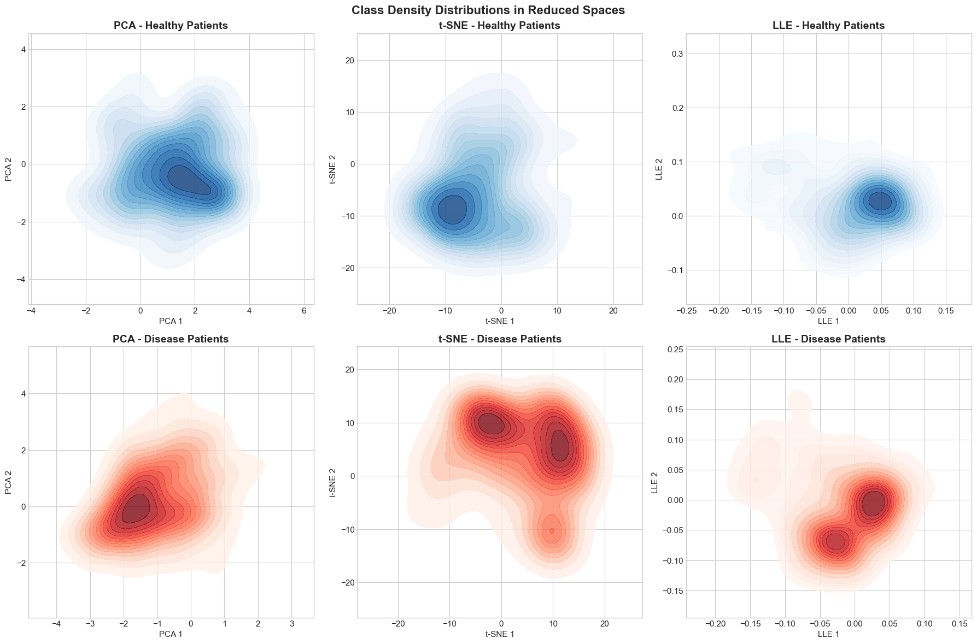
Class Density Distributions
Separation Quality
Density plots reveal how well each method separates healthy (blue) and disease (red) populations in reduced dimensional space.
t-SNE achieves the clearest separation with distinct bimodal distributions for the disease class.
Clinical Implications
The distinct density patterns suggest that:
Heart disease manifests as identifiable patient subgroups
Nonlinear methods better capture disease complexity
Multiple disease subtypes or progression stages may exist

Slide 12
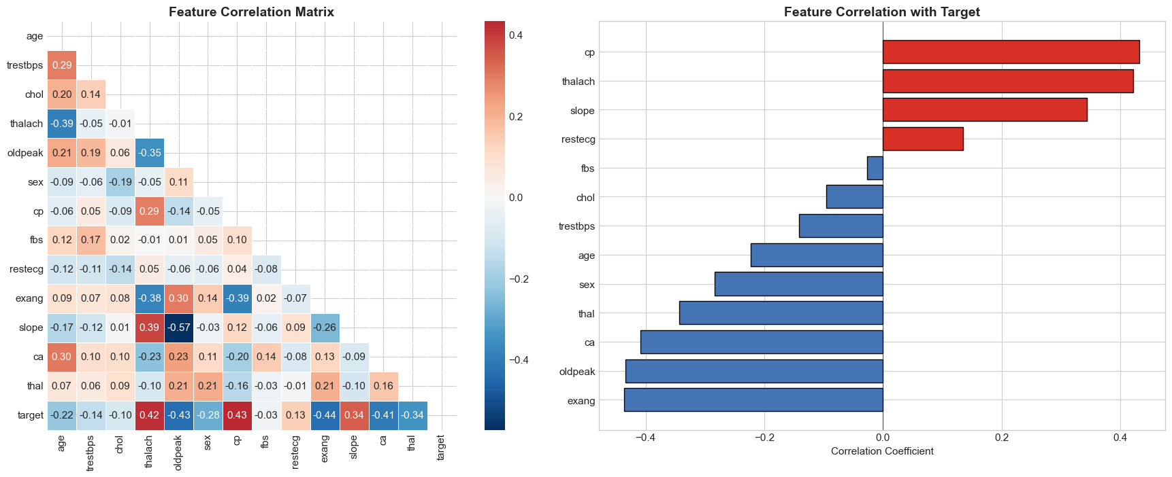
Feature Correlation & Clinical Insights
Top Positive Predictors
Negative Predictors
Feature Interactions
Chest pain type (cp): +0.43 correlation
Exercise-induced angina (exang): -0.44 correlation
Age correlates with blood pressure and cholesterol
Max heart rate (thalach): +0.42 correlation
Strong inverse relationship with disease presence
Complex multivariate relationships require nonlinear analysis
ST depression (oldpeak): Strong indicator
Validates clinical importance of stress testing
No single feature provides complete diagnostic picture

Slide 13
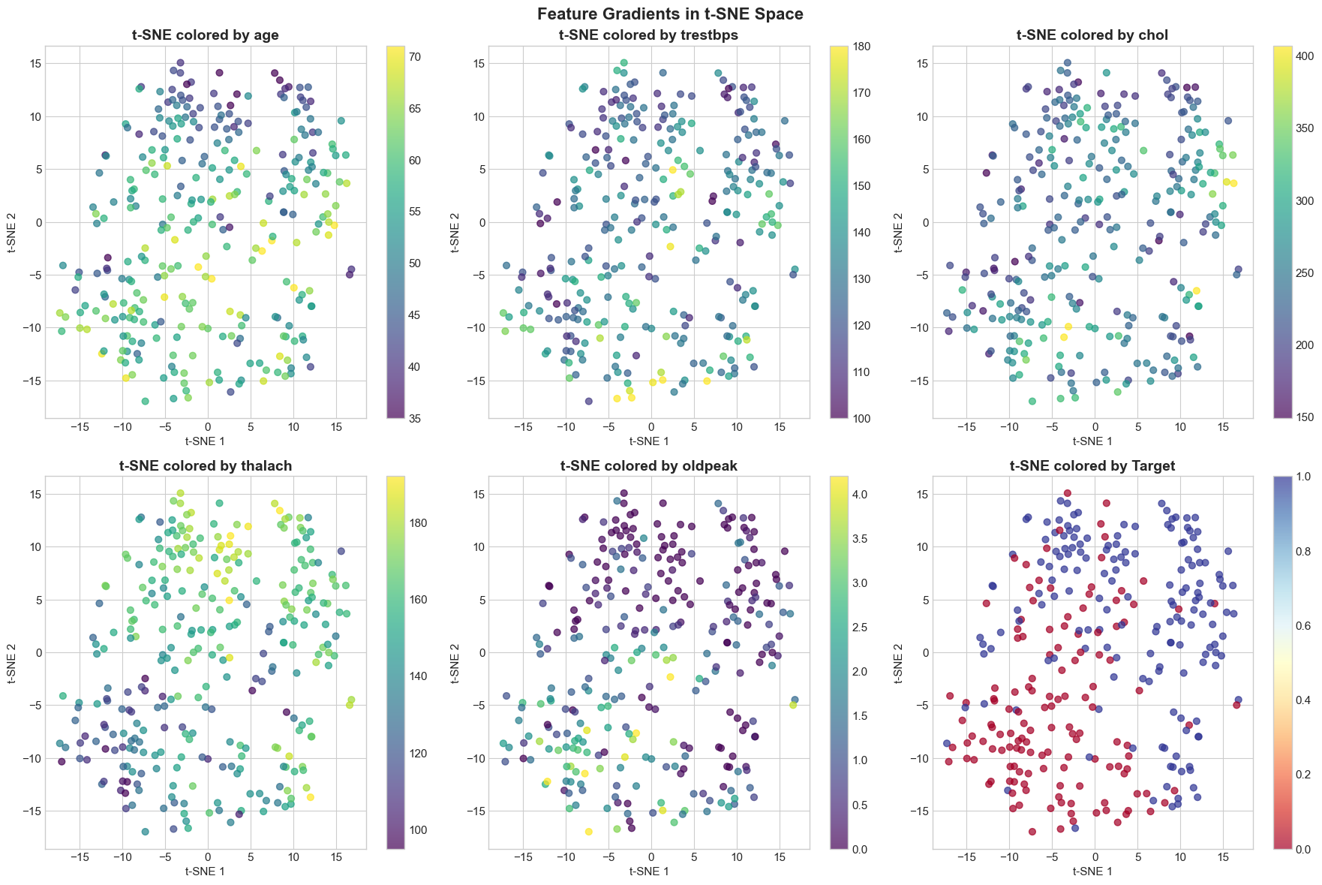
Feature Gradients in Embedding Space
Feature gradient visualization reveals which clinical measurements drive cluster separation in t-SNE space. Clear gradients for thalach and oldpeak indicate these features strongly influence the underlying cluster structure.

Slide 14
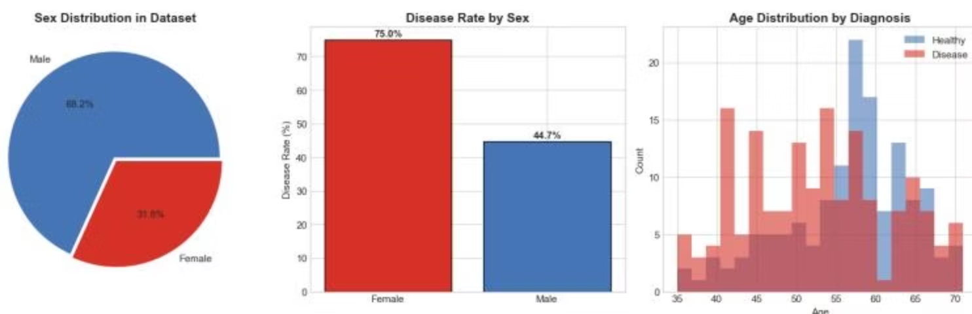
Ethical Considerations & Bias Analysis
Critical Bias Findings
Sex Imbalance
68.2% male sample limits generalizability to female population
Differential Disease Rates
75.0% disease rate in females vs 44.7% in males may reflect selection bias
Age Concentration
Data concentrated in 50-65 age range, limiting applicability to other age groups
Privacy & Compliance
Protected Health Information (PHI) under HIPAA requires proper de-identification, access controls, and GDPR compliance for European applications.

Slide 15
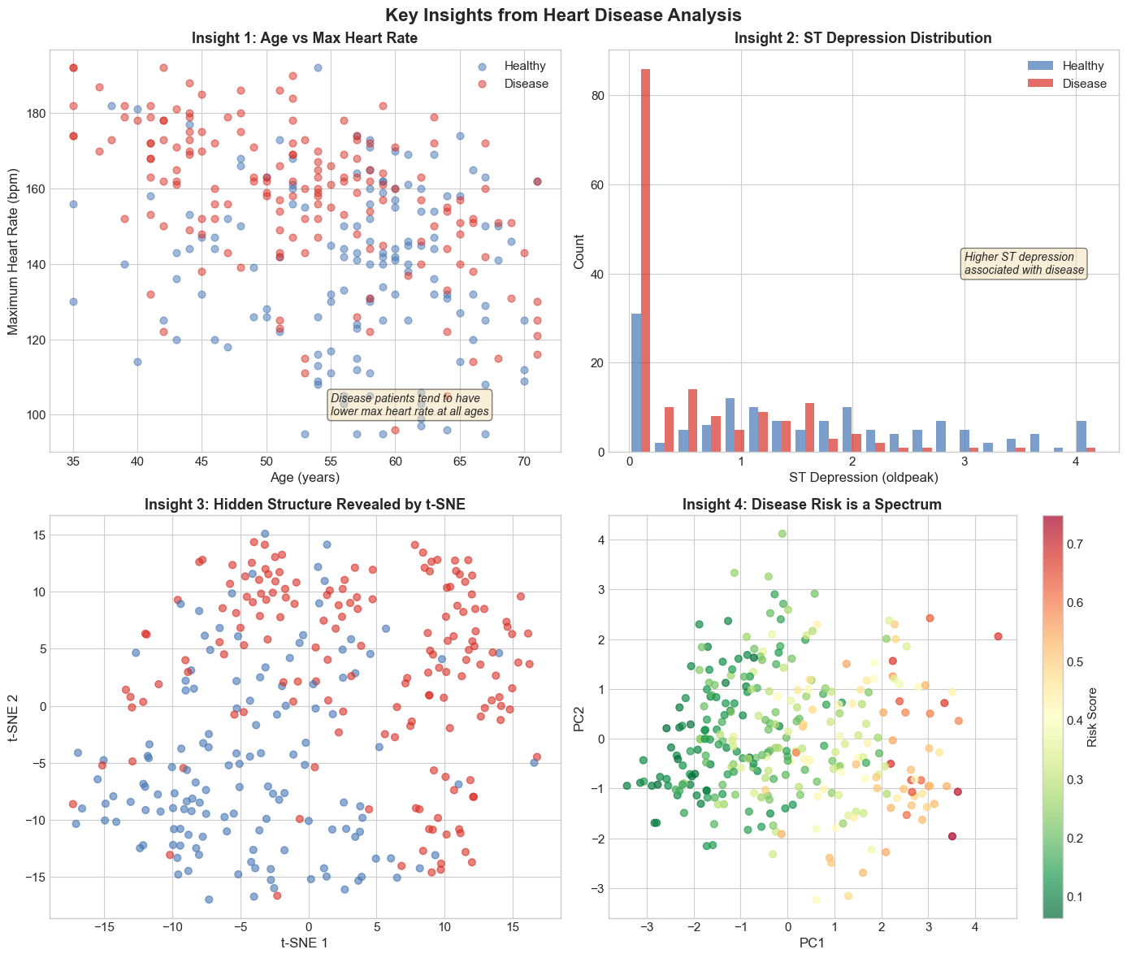
Key Insights
1
2
Healthy patients cluster near zero ST depression, while disease patients exhibit higher oldpeak values
3
t-SNE reveals hidden cluster structure with clearer separation between disease and healthy groups than linear methods
Disease patients consistently show lower maximum heart rate across all age groups compared to healthy individuals
4
Disease risk exists on a continuous spectrum rather than as a binary classification, with gradual transitions visible in PCA space

Slide 16

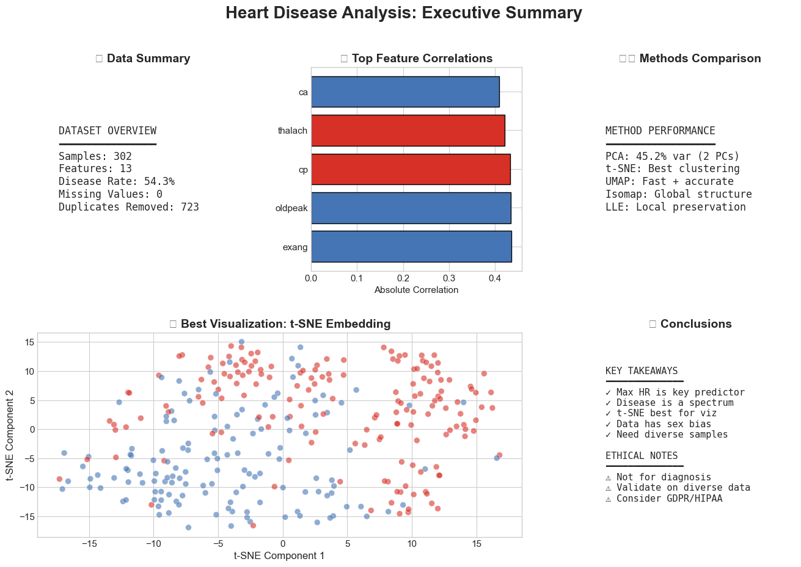




Conclusions & Recommendations
Data Quality is Critical
70.5% duplicate removal fundamentally changed the analysis landscape, demonstrating the importance of rigorous preprocessing
Nonlinear Methods Excel
t-SNE and UMAP reveal complex patterns invisible to PCA, achieving superior class separation and uncovering patient subgroups
Clinical Validation
Maximum heart rate and ST depression emerge as most informative predictors, validating exercise stress testing importance
Address Bias
Demographic imbalances require diverse data collection, regular fairness audits, and transparent limitation documentation
Responsible Deployment
Implement differential privacy, maintain human oversight, and ensure GDPR/HIPAA compliance for production systems

